Slide 1

Transforming Simulation Outcomes for Enhanced Decision-Making Accessibility
Noé Flandre
Research Project Presentation – Friday 11th June

Slide 2
Question
How to transform simulation outcomes into clear, unbiased explanations that support decision-making activities among non-experts?
Noé Flandre
Enhancing Simulations Outcomes for Decision-Making
2

Slide 3
Table of content
1
What I have done so far
2
What I plan to do next
Noé Flandre
Enhancing Simulations Outcomes for Decision-Making
3

Slide 4
What I have done so far
1
Noé Flandre
Enhancing Simulations Outcomes for Decision-Making
4

Slide 5

What I have done so far
1
2
3
Milk Consumption Behaviours
Megafaunal
Hunting
Pressure
Household
Behaviour Impact on Grazing and Livestock
Website : Comses.net
Noé Flandre
Enhancing Simulations Outcomes for Decision-Making
5

Slide 6
What I have done so far
GUI parameters
Documentation
Code
Method : Regular Expressions
Noé Flandre
Enhancing Simulations Outcomes for Decision-Making
6

Slide 7

What I have done so far
Metrics to follow
Number of runs
Parameters
Method : pynetlogo
Noé Flandre
Enhancing Simulations Outcomes for Decision-Making
7

Slide 8

What I have done so far
Method : pandas, matplotlib
Noé Flandre
Enhancing Simulations Outcomes for Decision-Making
8

Slide 9

What I have done so far
Ground Truth
Noé Flandre
Enhancing Simulations Outcomes for Decision-Making
9

Slide 10

What I have done so far
Method : base64
Noé Flandre
Enhancing Simulations Outcomes for Decision-Making
10

Slide 11
What I have done so far
Use of the API
1st Method : The ”one big prompt”
Noé Flandre
Enhancing Simulations Outcomes for Decision-Making
11

Slide 12
What I have done so far
1st Method : The ”one big prompt”
Documentation
Experiment parameters
GUI parameters
Constant prompt
Code
Noé Flandre
Enhancing Simulations Outcomes for Decision-Making
12

Slide 13
What I have done so far
1st Method : The ”one big prompt”
Constant prompt
8 final prompts
Features :
-Role
-Insights
-Example
Noé Flandre
Enhancing Simulations Outcomes for Decision-Making
13

Slide 14

What I have done so far
1st Method : The ”one big prompt”
Final prompt
Response
Noé Flandre
Enhancing Simulations Outcomes for Decision-Making
14

Slide 15
What I have done so far
1st Method : The ”one big prompt”
Flesch
ROUGE
BLEU
METEOR
Response
Noé Flandre
Enhancing Simulations Outcomes for Decision-Making
15

Slide 16
What I have done so far
1st Method : The ”one big prompt”
Human Assessment
Prompt
Refining
Noé Flandre
Enhancing Simulations Outcomes for Decision-Making
16

Slide 17
What I have done so far
Use of the API
2nd Method : The “Agents”
Noé Flandre
Enhancing Simulations Outcomes for Decision-Making
17

Slide 18


What I have done so far
2nd Method : The ”Agents”
Final prompt
Plot description
Explains the context
Analyzes the trends in the data
Noé Flandre
Enhancing Simulations Outcomes for Decision-Making
18

Slide 19
What I plan to do next
2
Noé Flandre
Enhancing Simulations Outcomes for Decision-Making
19

Slide 20
What I plan to do next
Manual Assessment to check all the responses
Refine the prompts until satisfaction
Apply the method with the features combination
Summarizing the context and the trend analysis within a report
Automatizing and linking the different functionalities
Writing a paper
Noé Flandre
Enhancing Simulations Outcomes for Decision-Making
20

Slide 21
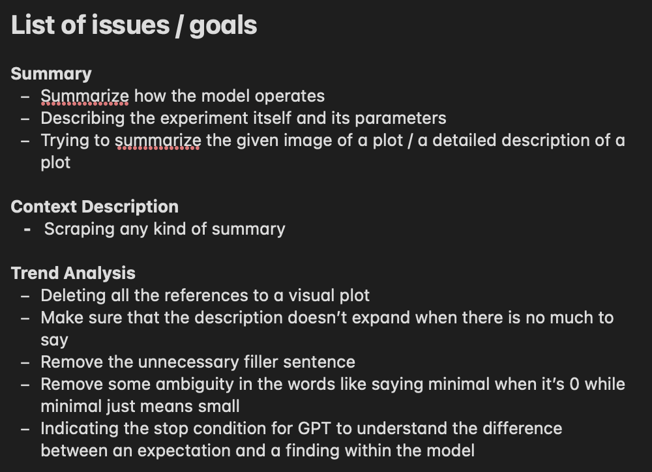
What I plan to do next
Noé Flandre
Enhancing Simulations Outcomes for Decision-Making
21

